Slide 1
React Hooks at a glance
Thien Nguyen and Nhat Nguyen

Slide 2
Overview
Introduce basic hooks APIs
Custom hooks
Some additional hooks
Best practices for hooks

Slide 3
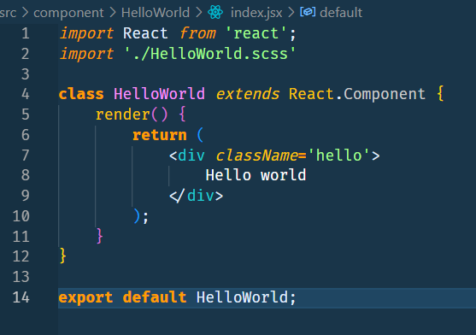
Overview
React component

Slide 4
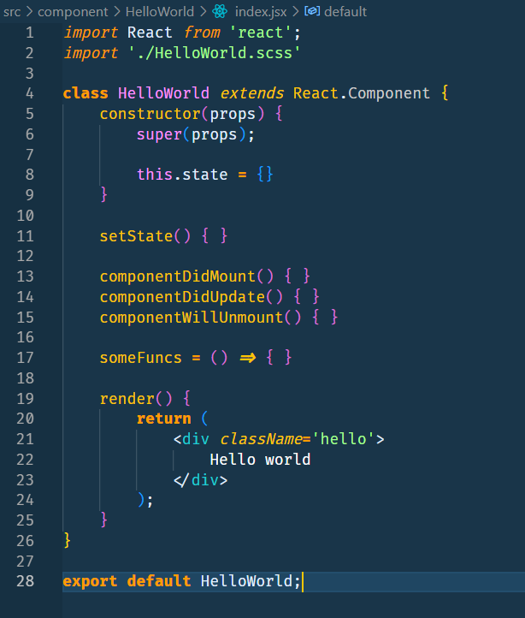
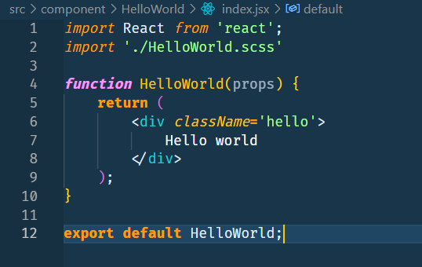
Overview
Class component
Functional component
Notes:
Unable to use life cycle in functional
Stateless

Slide 5
Overview
Class components
Retain internal state
Have lifecycle interaction
Complex
Not easy to test logic
Pure functions
No state, no lifecycle
Simple
Easy to reuse
Easy to test
Stateful
Stateless

Slide 6
Overview
What we saw here?
Javascript is functional programming
Class components become more complex and difficult to maintain and test
Class components have lifecycle functions can cause confusion
What is Hooks?
Functions that enhance Functional components with state maintaining and side-effects capabilities
Introduce in React 16.8

Slide 7

Overview
What hooks can do
Simple and reduce many lines of codes
Let us use state in functional components
Functional components no longer stateless now

Slide 8
Introduce hooks APIs
useState
A basic hooks that make functional components can use state
const [state, setState] = useState(initState);
setState(newState);

Slide 9
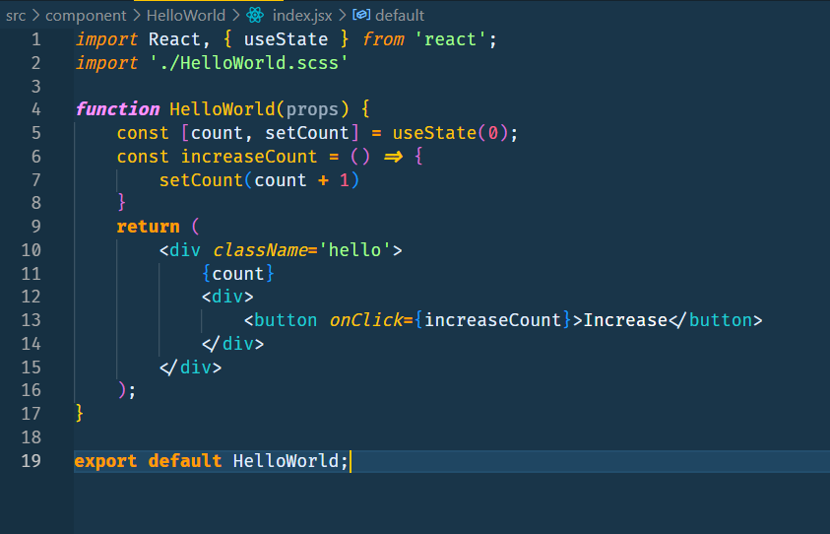
Introduce hooks APIs
useState
Notes:
Code demo here HelloWorld

Slide 10
Introduce hooks APIs
useState – a notice point
// setState() in class component: MERGING
this.state = { name: 'Thien', role: 'dev' };
this.setState({ role: 'qa' });
// => result: { name: 'Thien', role: 'qa' }
// useState() in functional component: REPLACING
const [person, setEmp] = useState({ name: 'Thien', role: 'dev' });
setEmp({ role: 'qa' });
// => result: { color: 'green' }

Slide 11
Introduce hooks APIs
solution
// useState() in functional component: REPLACING
const [person, setEmp] = useState({ name: 'Thien', role: 'dev' });
setEmp({ ...person, role: 'qa' });
// => result: { name: 'Hau', role: 'qa' }

Slide 12
Introduce hooks APIs
useEffect
A basic hooks that use for side effects:
Call APIs to get datas
Interaction with DOM
Subscriptions
setTimeout, setInterval

Slide 13
Introduce hooks APIs
useEffect
useEffect(() => {
// do your side effect here
return () => {
// Clean up
// Executed before the next render or unmount
};
}, []);

Slide 14
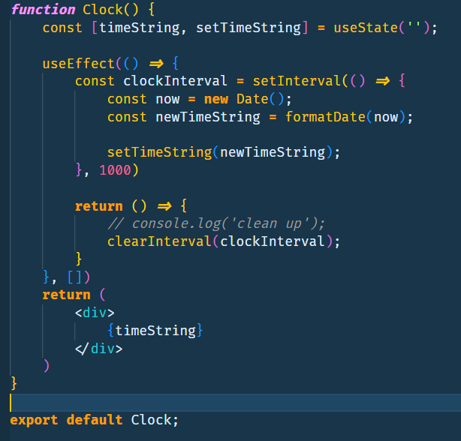
Introduce hooks APIs
useEffect
Notes:
Code demo here HelloWorld
Code demo here Clock

Slide 15
Introduce hooks APIs
useEffect – with no condition
useEffect(() => {
// EVERY
// No dependencies defined
// Always execute after every render
return () => {
// Execute before the next effect or unmount.
};
});

Slide 16
Introduce hooks APIs
useEffect – with condition is empty dependencies
useEffect(() => {
// ONCE
// Empty dependencies
// Only execute once after the FIRST RENDER
return () => {
// Execute once when unmount
};
}, []);

Slide 17
Introduce hooks APIs
useEffect – with condition is no-empty dependencies
useEffect(() => {
// On demand
// Has dependencies
// Only execute after the first RENDER or filters state changes
return () => {
// Execute before the next effect or unmount.
};
}, [filters]);

Slide 18
Introduce hooks APIs - useEffect
class App extends PureComponent {
componentDidMount() {}
componentWillUnmount() {}
}
function App() {
useEffect(() => {
console.log(‘Comp Did Mount');
return () => {
console.log(‘Comp Will Unmount’);
};
}, []);
}
Class component
Functional component

Slide 19
Introduce hooks APIs - useEffect
class App extends PureComponent {
componentDidMount() {}
componentDidUpdate() {}
}
function App() {
useEffect(() => {
console.log(‘Comp Did Mount or did update');
});
}
Class component
Functional component

Slide 20
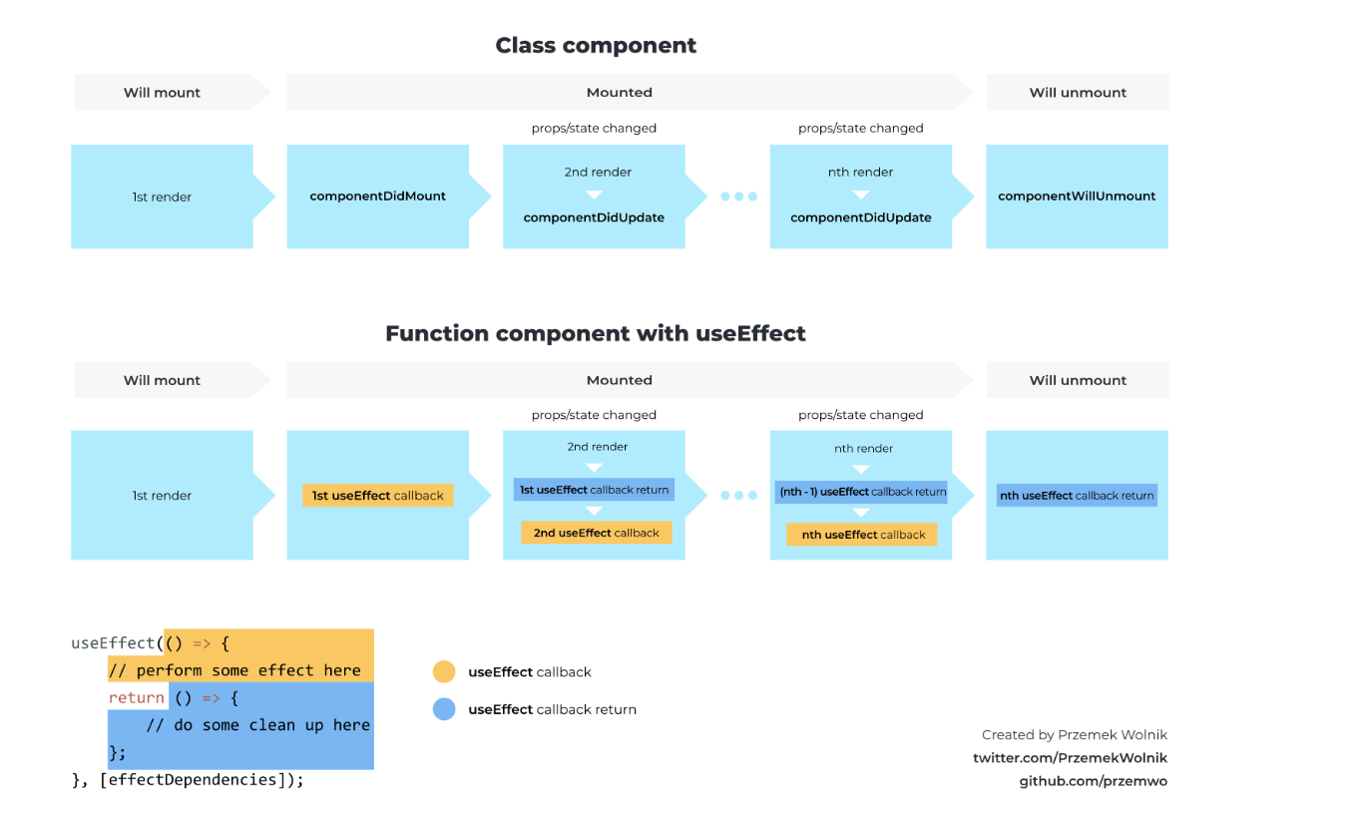
Introduce hooks APIs
useEffect
Notes:
Code demo here HelloWorld
Code demo here Clock

Slide 21
Custom hooks
What is custom hooks?
React allows us to write a custom hooks same as useState and useEffect
Custom hooks is a special function
It can use other hooks like useState, useEffect,… or another custom hooks
RULE: Use ‘use’ keyword to write a custom hooks -> useClock, useColor,…
Custom hooks return data instead of JSX
When to use?
Separate the logic from the UI
Share logic between components

Slide 22
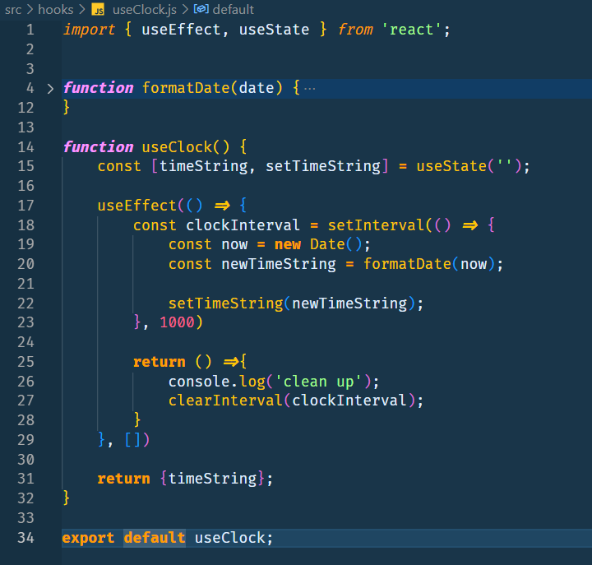
Custom hooks
Notes:
Code demo here BeautifulClock

Slide 23
Some additional hooks
useRef
const [count, setCount] = useState(0);
const prevCount = useRef(count)
useEffect(() => {
prevCount.current = count;
}, [count]);
Allow to store, retrieve stateful values => can get a previous state to use for any purposes

Slide 24
Some additional hooks
useCallback
function App() {
const handleMapTypeChange = (type) => { }
return <Chart onTypeChange={handleMapTypeChange} />;
}
function App() {
const handleMapTypeChange = useCallback((type) => { }, [])
return <Chart onTypeChange={handleMapTypeChange} />;
}
Create a memorized callback and only create a new callback when dependencies changed.

Slide 25
Some additional hooks
useMemo
function App() {
const data = [{}, {}, {}];
return <Map data={data} />;
}
function App() {
const data = useMemo(() => [{}, {}, {}], [])
return <Map data={data} />;
}
Create a memorized value and only calculate a new value when dependencies changed.

Slide 26
Best practices for hooks

